Slide 1
LAW OF DEMAND

Slide 2
DEMAND
The term Demand is often heard and understood in different ways in different contexts. More precisely, in economic terminology Demand is the quantity of a good or service that consumers are willing and able to purchase during a specified period under a given set of economic conditions.
Without demand, no business would ever bother of producing anything and there is no existence of any economic activity.

Slide 3
To create Demand, we need:
Desire to buy a product
Ability to buy a product
Willingness to buy a product
Therefore, Demand =
Desire + ability to buy + Willingness to buy

Slide 4
LAW OF DEMAND
The law of demand governs the relationship between the quantity demanded and the price.
This economic principle describes something you already intuitively know. If the price increases, people buy less. If the price decreases, people buy more.
If Price Demand
If Price Demand
But price is not the only determining factor, it depends upon its other determinants also.

Slide 5
DEMAND FUNCTION / DETERMINANTS :
This shows the relationship between the demand of a commodity and its determinants.
D x = f(Y , P x , Ps, Pc , T , E p , E y , N , D ,μ)
Y = Income of the consumer
P x = Price of the commodity X
Ps = Price of substitution goods of X
Pc = Price of complementary goods of X
T = Taste and preference of the consumers
E p = Future price expectations
E y = Future income expectations
N = Number of Consumers
D = Distribution of consumers
μ = Some other determinants

Slide 6
ASSUMPTIONS OF LAW OF DEMAND
Main assumptions of the law of demand are as follows:
Prices of the related goods should be constant.
Incomes of the consumers should not change.
Tastes and preferences of the consumers remain constant.
No expectation in the change in price of the commodity in the near future.

Slide 7
Definition of Law of Demand
The Law of Demand can be stated as “Other things being equal, higher the price of the commodity, lower is the quantity demanded and lower the price, higher is the quantity demanded”.
The law of Demand can be explained with the help of following table and diagram.

Slide 8
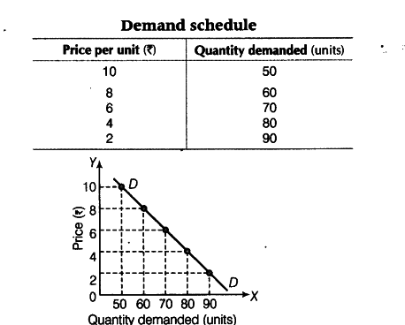
EXPLANATION OF THE LAW

Slide 9
EXCEPTIONS OF LAW OF DEMAND
Giffen's Paradox
Conspicuous goods like gold , diamonds etc.
At the time of speculation.
Outdated Goods.
Future expectations about prices.
Veblon Goods.

Slide 10
THANK YOU!!!

